Slide 1
Module - 01

Slide 2
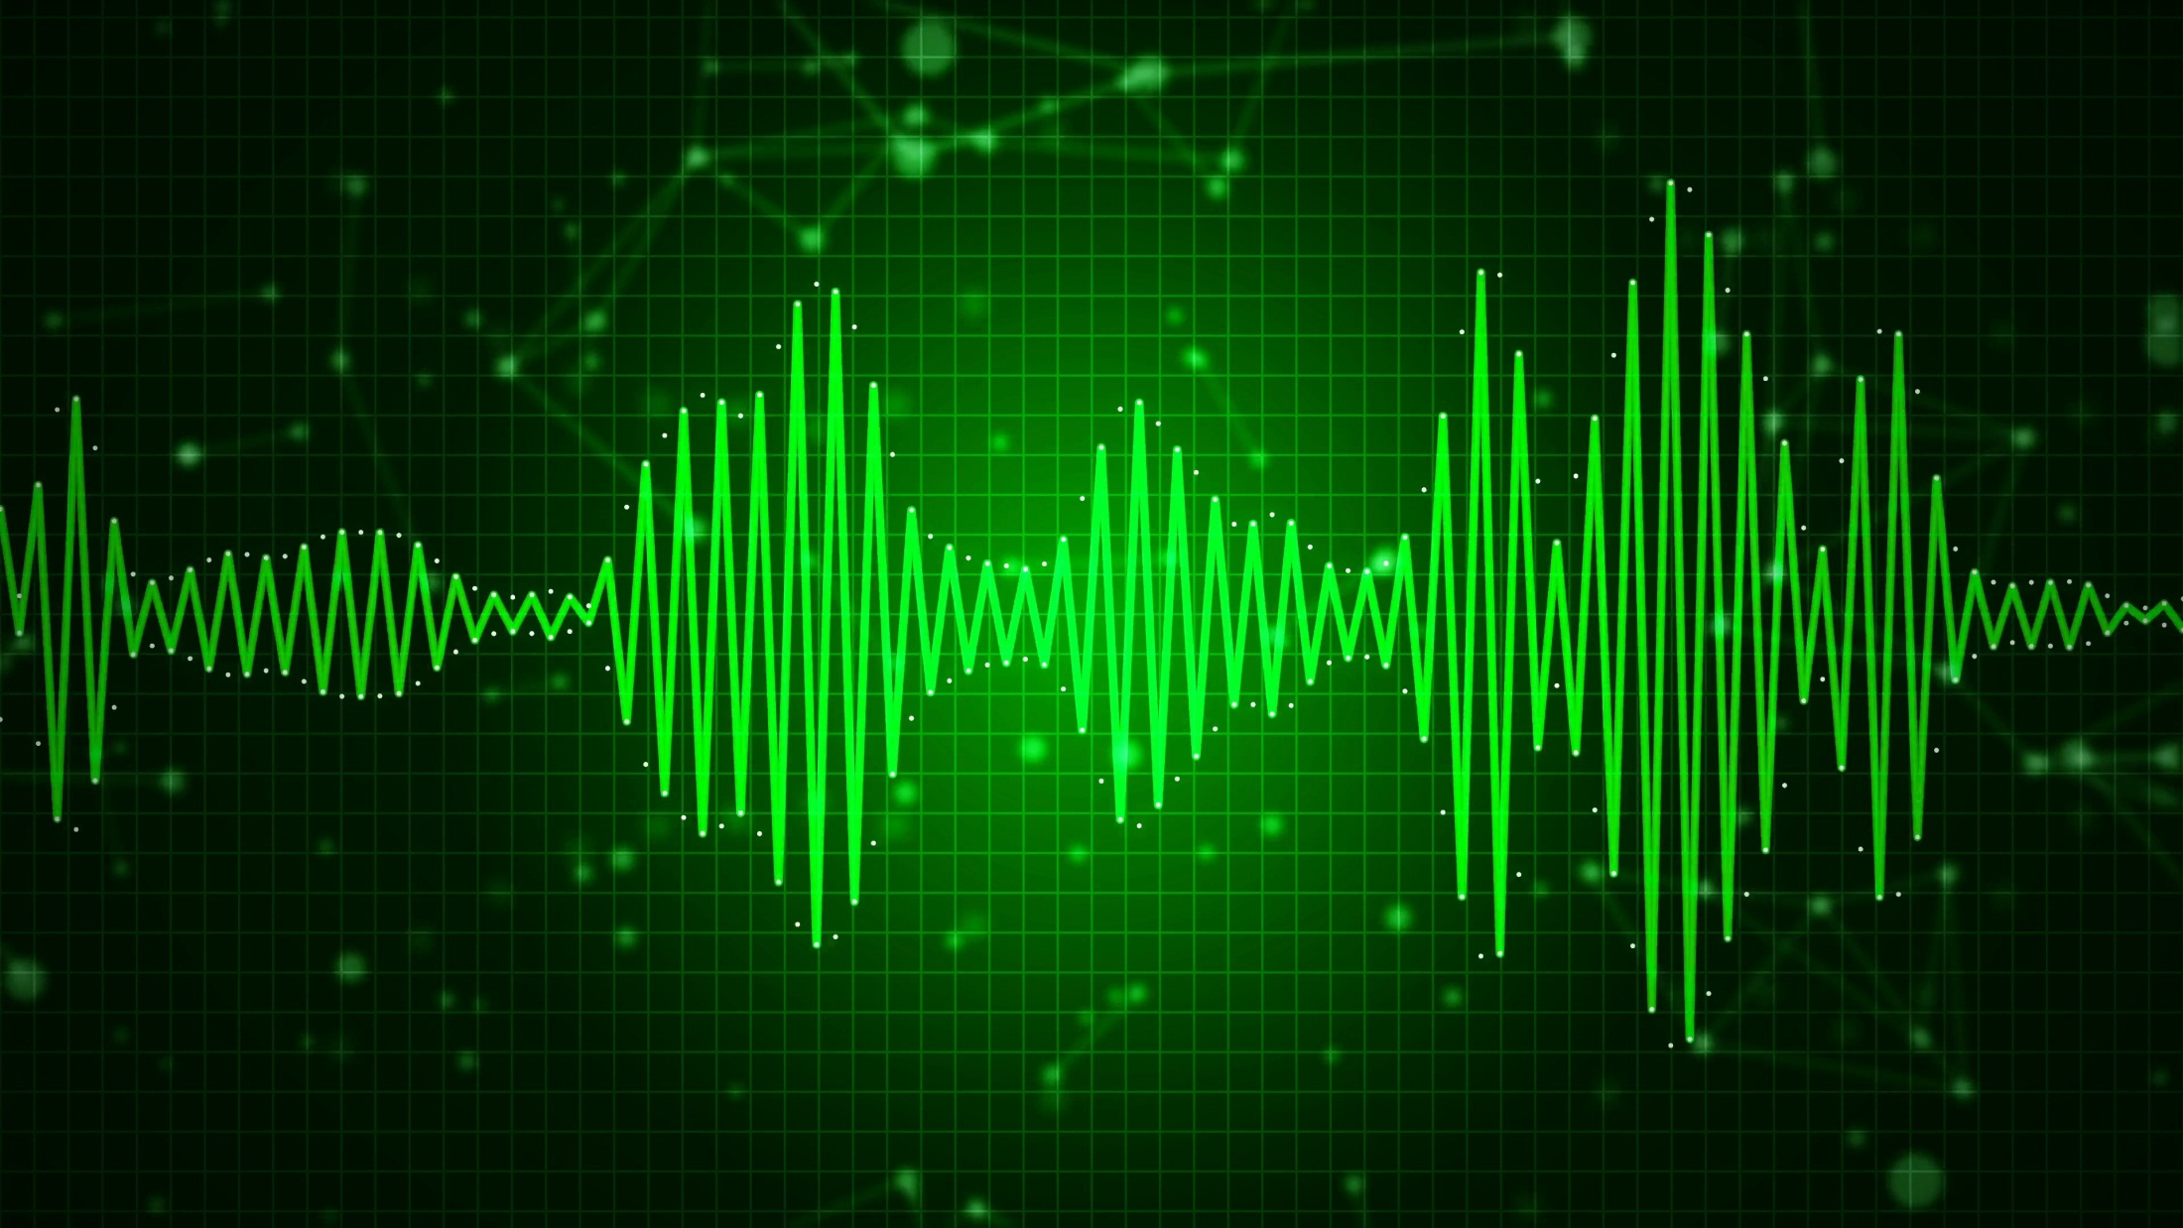
01
SOUND
02
WAVE MOTION
TYPES OF WAVES – ELECTROMAGNETIC WAVES AND MECHANICAL WAVES
03

Slide 3




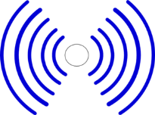


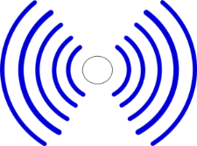

sound
Sound is a form of energy which produces sensation of hearing in our ears.
SOUND is produced by
a vibrating source.
How is SOUND produced?

Slide 4

Sound travels in the form of wave
PULSE:
A single disturbance travelling through a medium is a PULSE
1
1
2
2
3
3
4
4
If continuous disturbance is produced, the particles vibrate continuously
Sea waves
What are waves?
This continuous motion forms a WAVE.
WAVE
A wave motion is a mode of transmission of energy through a medium.
1
2
3
4
The particle do not move from one place to another. They just vibrate about their mean position

Slide 5
Module - 02

Slide 6
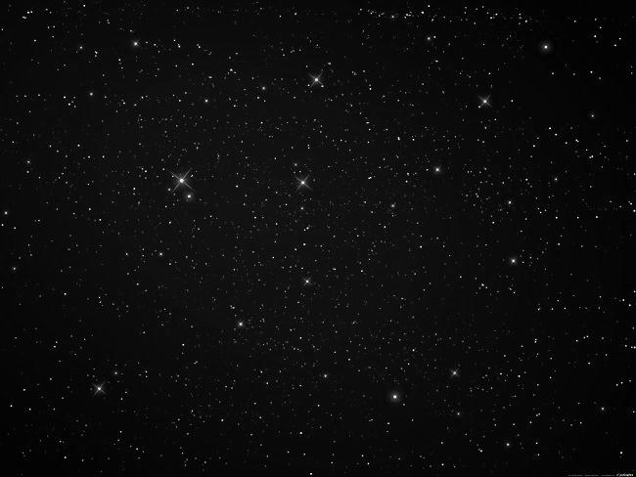



Types of Waves
The rays of light that travel from the sun to the earth are electromagnetic waves as they travel through vacuum.
Electromagnetic Wave
Mechanical Or Elastic Waves

Slide 7
Mechanical waves
Waves which require a material medium like solid, liquid or gas
Transverse wave
Longitudinal wave

Slide 8

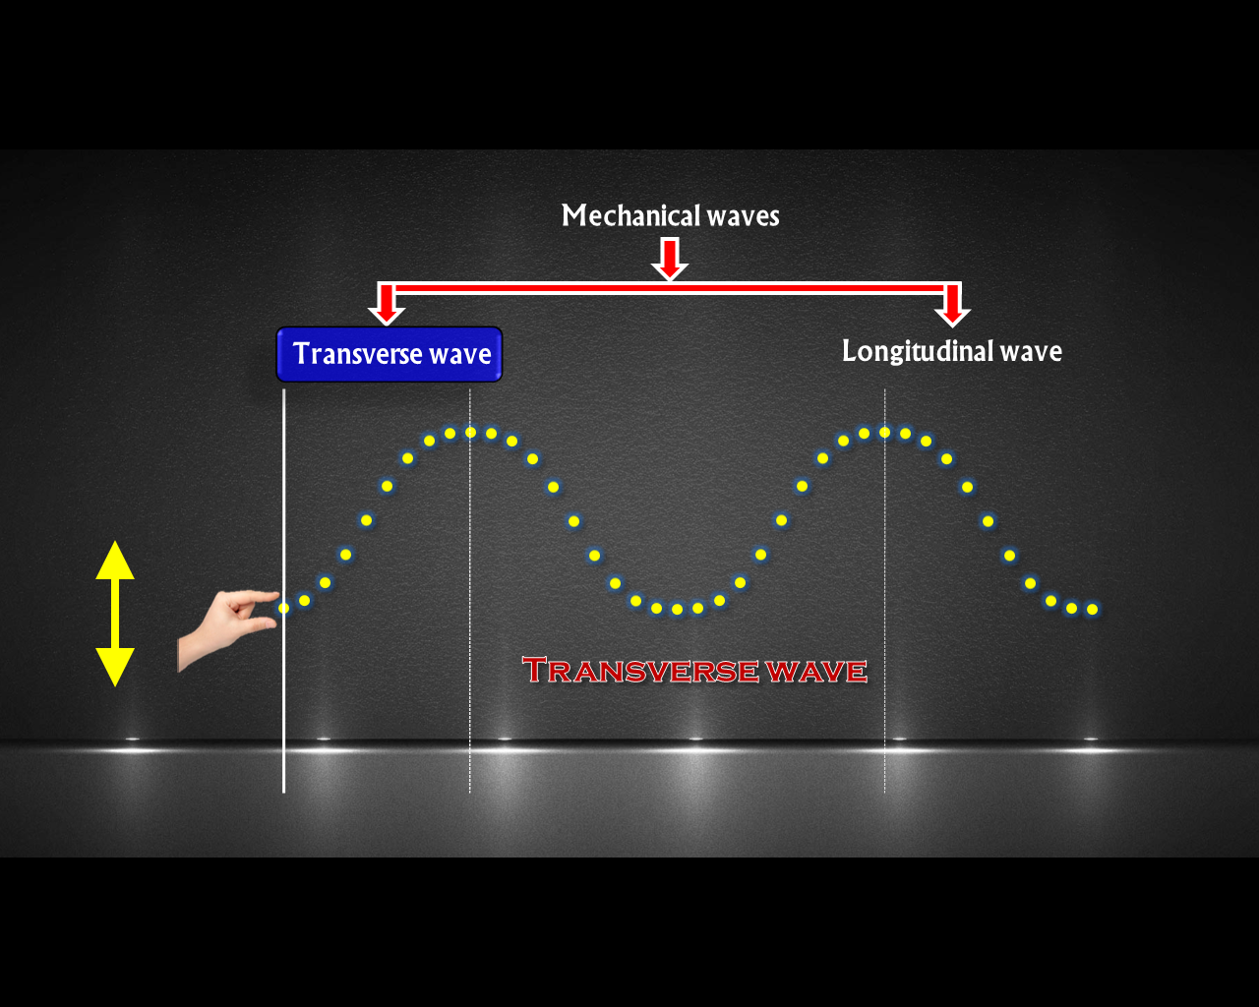
Transverse wave
In transverse waves, the particles of the medium oscillate about their central or mean positions, in a direction perpendicular to the propagation of the wave.
Transverse wave
Crest
Direction of Wave
90⁰
Trough`.
Direction of oscillation

Slide 9
Mechanical waves
Transverse wave
Longitudinal wave

Slide 10
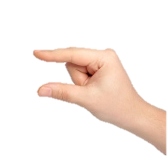
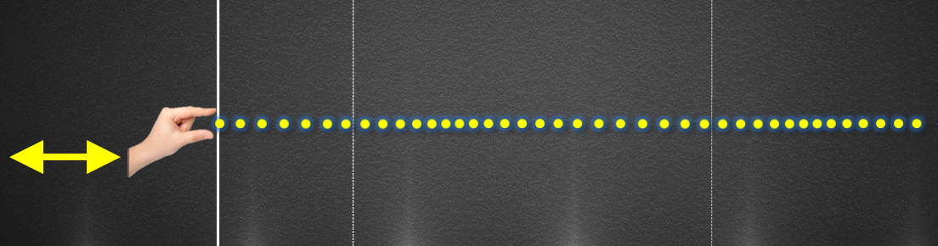
Longitudinal wave
In longitudinal waves, the particles of the medium oscillate about their central or mean positions, in a direction parallel to the propagation of the wave.
Longitudinal wave
Direction of Wave
Compression
Rarefaction
Direction of oscillation

Slide 11

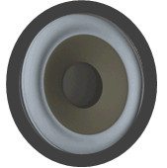

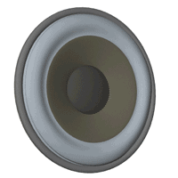

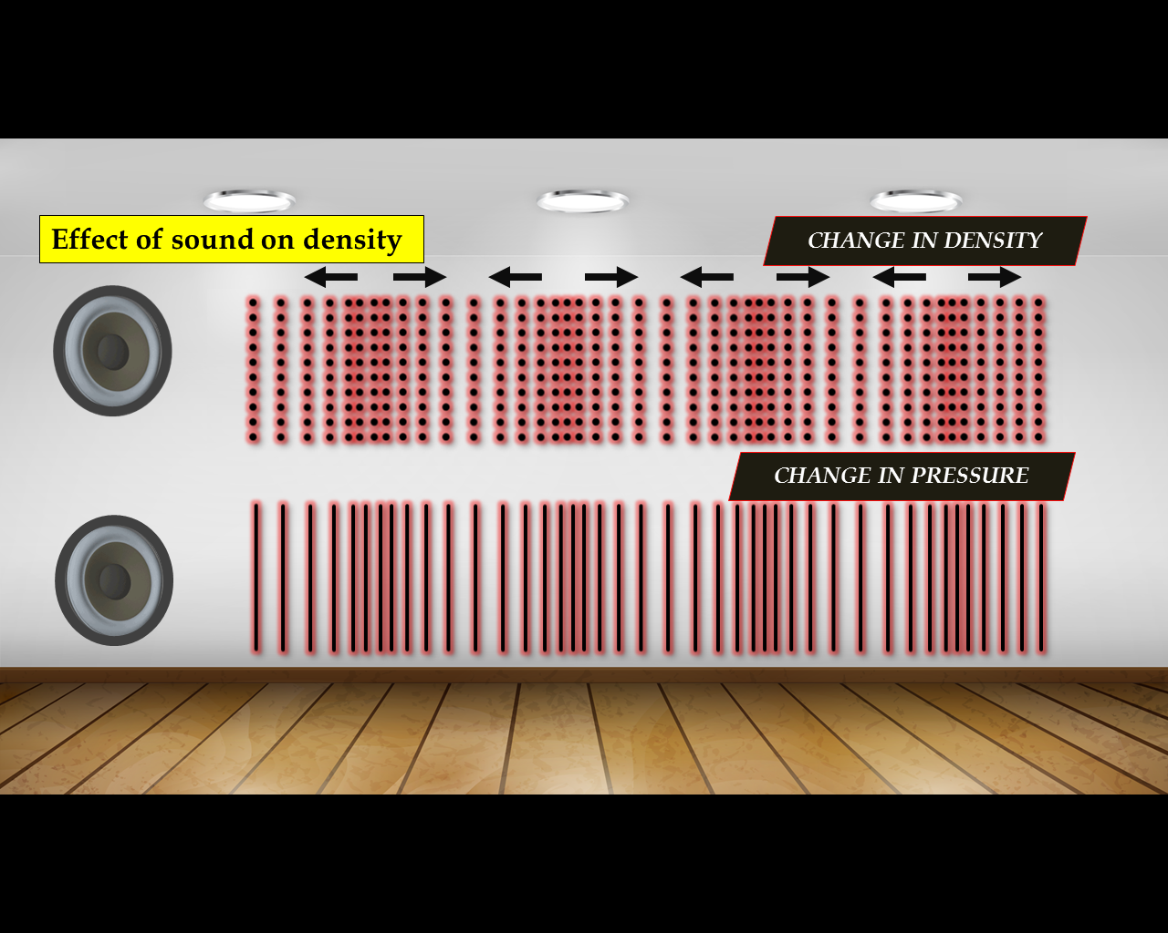
Effect of sound on density
Equidistant layers of air
Region of
HIGH DENSITY
Region of
LOW DENSITY
Effect of sound on pressure
Low pressure region
R
C
R
C
R
C
R
C
Equidistant particles of air
High pressure region
Compression
Rarefaction
R
C
R
C
R
C
R
C

Slide 12

GRAPH FOR CHANGES IN DENSITY
HIGH
DENSITY
AVERAGE density
LOW
DENSITY

Slide 13

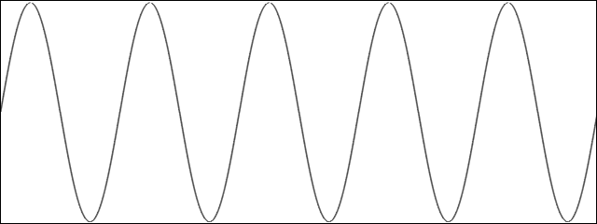

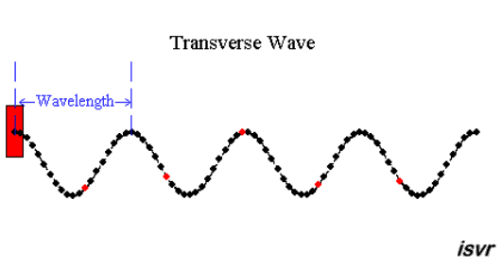
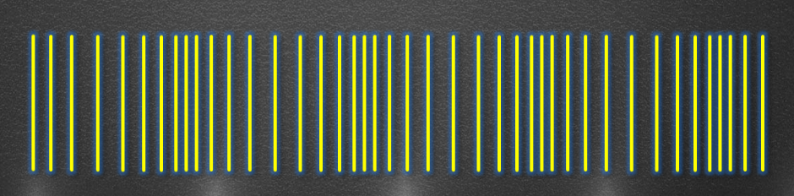
Difference between Transverse wave & Longitudinal wave
TRANSVERSE WAVE
LONGITUDINAL WAVE
TRANSVERSE WAVE
LONGITUDINAL WAVE
1. In transverse waves, the particles of the medium oscillate about their central or mean positions, in a direction perpendicular to the propagation of the wave.
1. In longitudinal waves, the particles of the medium oscillate about their central or mean positions, in a direction parallel to the propagation of the wave.
2. It consist of compressions and rarefactions
2. It consist of crest and trough
Crest
Compression
3. e.g. Waves on the surface of water
3. e.g. Sound waves
Trough
Rarefaction

Slide 14

Q. Why are sound waves called mechanical waves?
Ans :
Sound waves are called mechanical waves because they need a material medium, solid, liquid or gas, for their propagation.
The sound waves involve vibration of particles of the medium through which they travel.
Q. In the given curve, half the wavelength is
B
D
A
E
C
(a) AB
(b) BD
(c) DE
(d) AE

Slide 15
Module - 03

Slide 16
01
PROPAGATION OF SOUND THROUGH AIR
02
SOUND CANNOT TRAVEL THROUGH VACUUM

Slide 17

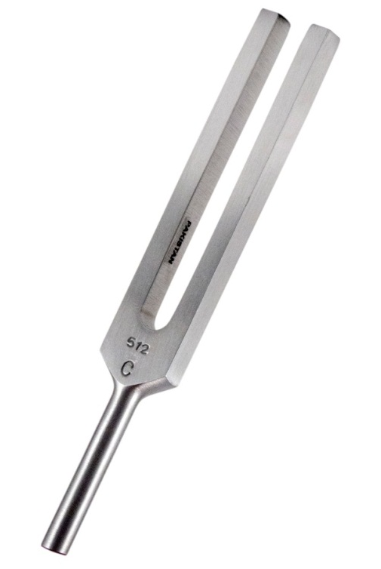
Sound is a longitudinal wave
How does sound travel through air ?
Prongs
Stem
TUNING FORK

Slide 18




Sound is a longitudinal wave
Prongs
How does sound travel through air ?
Equidistant layers of air
Stem
Prongs outwards
Compression
Prongs inwards
Rarefaction
Compression

Slide 19




Slide 20

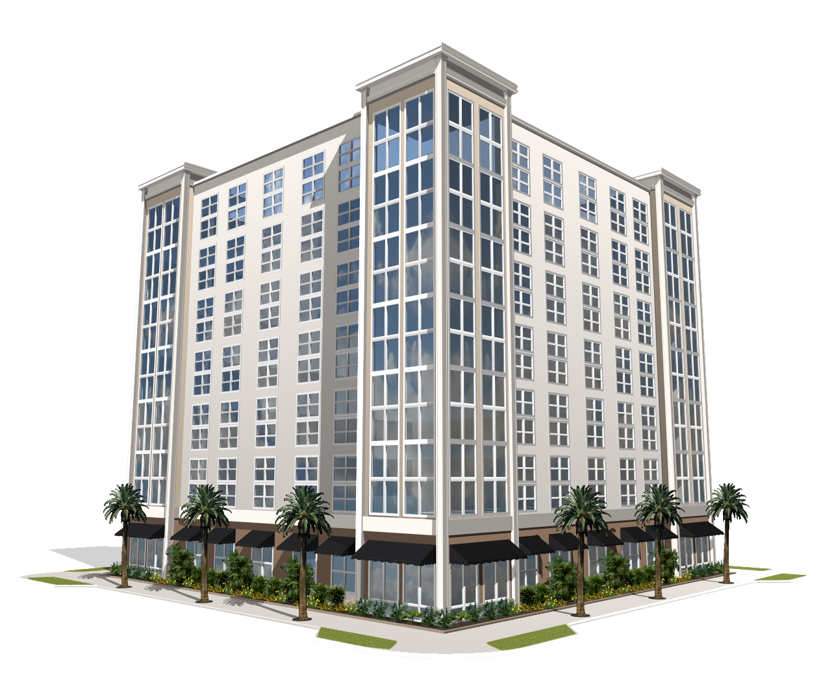

How does sound travel through air when we talk ?
Hello....
Air column (particles of air)
Hello

Slide 21



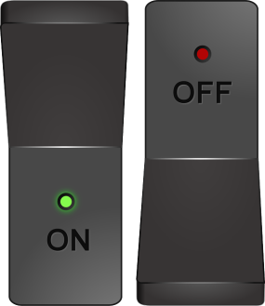

To show that sound cannot travel through vacuum
Bell Jar
Conclusion
Electric bell
Thus we can conclude that for the sound to be produced we require a material medium like air, water etc.
OFF
OFF
To vaccum
pump
ON

Slide 22
Q. A sound producing body is at a considerable distance from a man. There can be four different media W, X, Y, Z between the sound producing body and the man. The medium X brings the sound to a man most quickly whereas medium Z takes the maximum time. The time taken by medium W in bringing the sound to the man is less than that of X but more than that of Z. The medium Y, however, fails to bring the sound from the sound producing body to the man.
Which of the medium could be the one :
(a) Having no fixed shape and no fixed volume?
Medium Z (gas)
(b) Having a fixed volume but no fixed shape?
Medium W (liquid)
(c) Having same composition as that on moon?
Medium Y (vacuum)
(d) Having fixed shape and a fixed volume?
Medium X (solid)

Slide 23
Module - 04

Slide 24

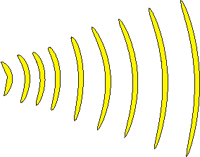
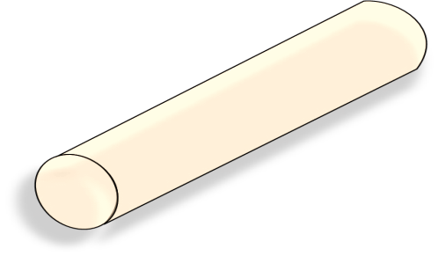



Reflection of sound
θ₁
θ₂
Conclusion
Cardboard
tubes
1. The direction of the incident wave and reflected wave make equal angles with the normal
Clock
2. The incident wave reflected wave and normal lie on the same place.
Normal
Observer

Slide 25

Q. For the loudest ticking sound to be heard by the ear, find the value of x in the figure.
O
A
50°
50°
B
x
x
C
D
N
For loudest ticking sound to be heard, ∠i = ∠r i.e. ∠CON = ∠BON = x
But, ∠AON = 90°
∴ ∠AOC + ∠CON = 90°
50° + x = 90°
x = 90° − 50° = 40°

Slide 26
Q. The figure given below shows an incident pulse P reflected from a rigid support. which out of the four represents the reflected pulse correctly.
(P)
(A)
(B)
(C)
(D)
(a) A
(b) B
(c) C
(d) D

Slide 27

STUDY OF SOUND
Echo
Conditions for echo

Slide 28

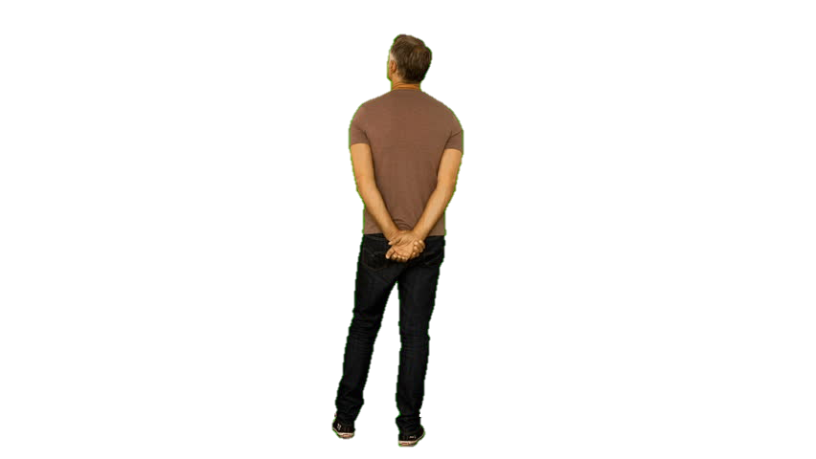
ECHO
ECHO
The repetition of sound due to reflection from a distant surface is called ECHO.

Slide 29

Conditions required to hear reflected sound clearly
Echo can be heard only if the distance between the observer and the reflecting surface is at least 17.2 meters.
distance
velocity
=
time
∴ distance = velocity × time
∴ distance = 344 × 0.1
∴ distance = 34.4 m
velocity of sound in air = 344 m/s

Slide 30
Conditions required to hear reflected sound clearly

Slide 31

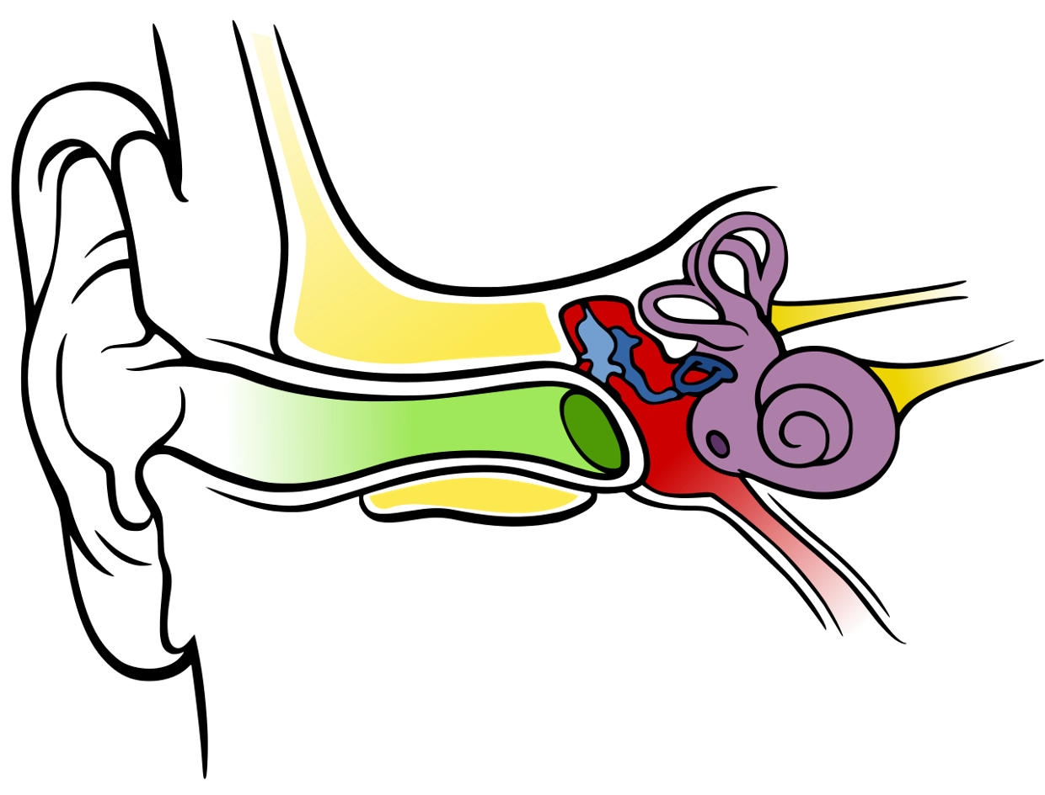

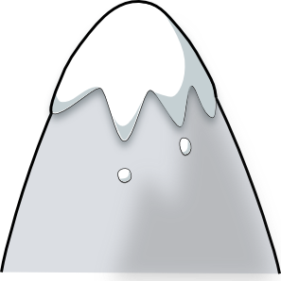
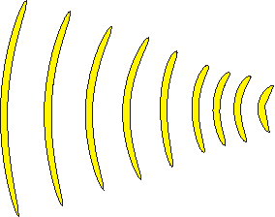

Conditions required to hear reflected sound clearly
At 22° C, the speed of sound in air is 344 m/s. To hear a distinct echo, the sound wave should more than 0.1 s after starting from the source to get reflected and come back to us.
Brain processes the sound and we are able to understand it.
When the two sounds enter the ear in more than 1/10th of a second both the sounds can be understood
When two sounds enter the ear within 0.1 second then brain understands it as one single sound
Echo can be heard only if the distance between the observer and the reflecting surface is at least 17.2 meters.
distance
∴ distance = velocity × time
velocity
=
time
∴ distance = 344 × 0.1
The sound should travel the distance of 34.4 m
i.e. the distance between the observer and the reflecting surface should be minimum 17.2 m
∴ distance = 34.4 m
Hello
Hello
velocity of sound in air = 344 m/s
Hello
Hello
Hello
Human ear
17.2 m

Slide 32
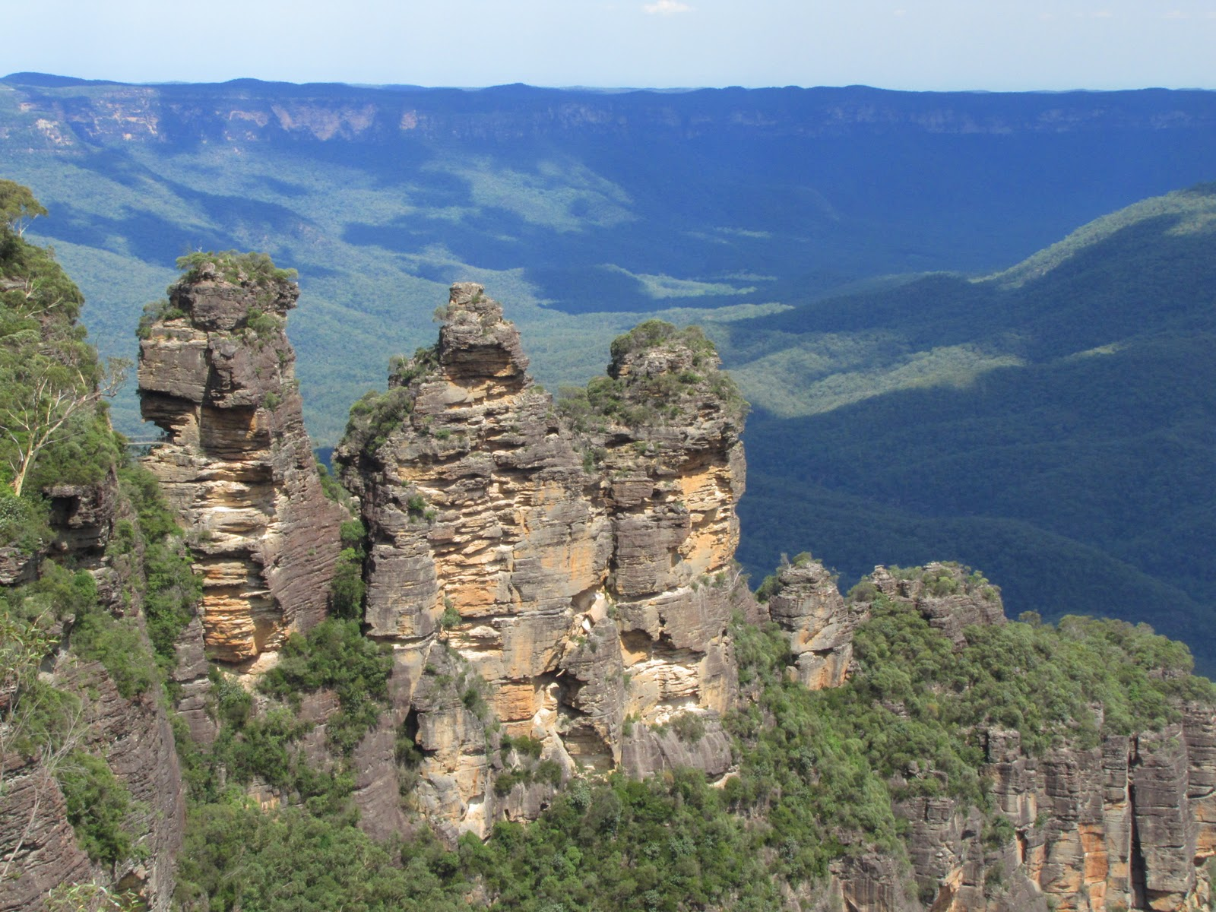

Echo can only be heard if the surface is rigid.
Why echo is not heard everywhere?

Slide 33

Echo cannot be heard if the mountains are covered with trees, because trees absorb sound.
Can echo be heard at this place?

Slide 34
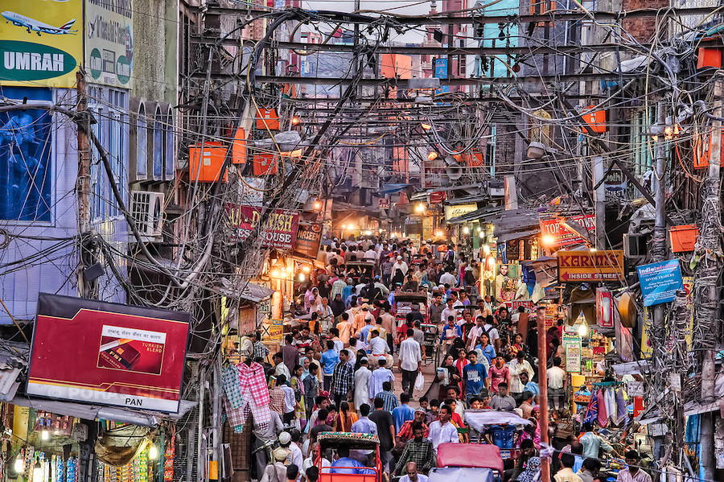
Echo cannot be heard because there is too much disturbance.
Can echo be heard at this place???

Slide 35

Furniture in the house absorbs the sound hence, echo is not heard.
Can echo be heard in a furnished house?

Slide 36
Q. If the distance d between the source and the sound is increased to 4d and the velocity v of the sound is doubled, then what will be the time t, after which the echo could be heard?
2d
For echo to be heard :
v
=
t
2d
i.e.
t
=
………(1)
v
d₁
= 4d,
v₁
= 2v
2
4
2d
2d₁
2
×
4d
d
t₁
=
=
=
2
×
=
2 t
…….. [From (1)]
2v
2
v
v₁
v

Slide 37
Q. If the speed of sound is reduced by 1/3 and time for the echo to be heard is doubled, will the echo be heard?
(a) Yes
(b) No

Slide 38
Module - 05

Slide 39

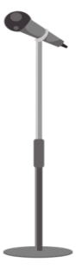

Reverberation
Sound waves get reflected from the walls and roof of a room multiple time. This causes a single sound to be heard not once but continuously. This is called reverberation.
Reflected sound
Singer
Direct sound
Listener

Slide 40
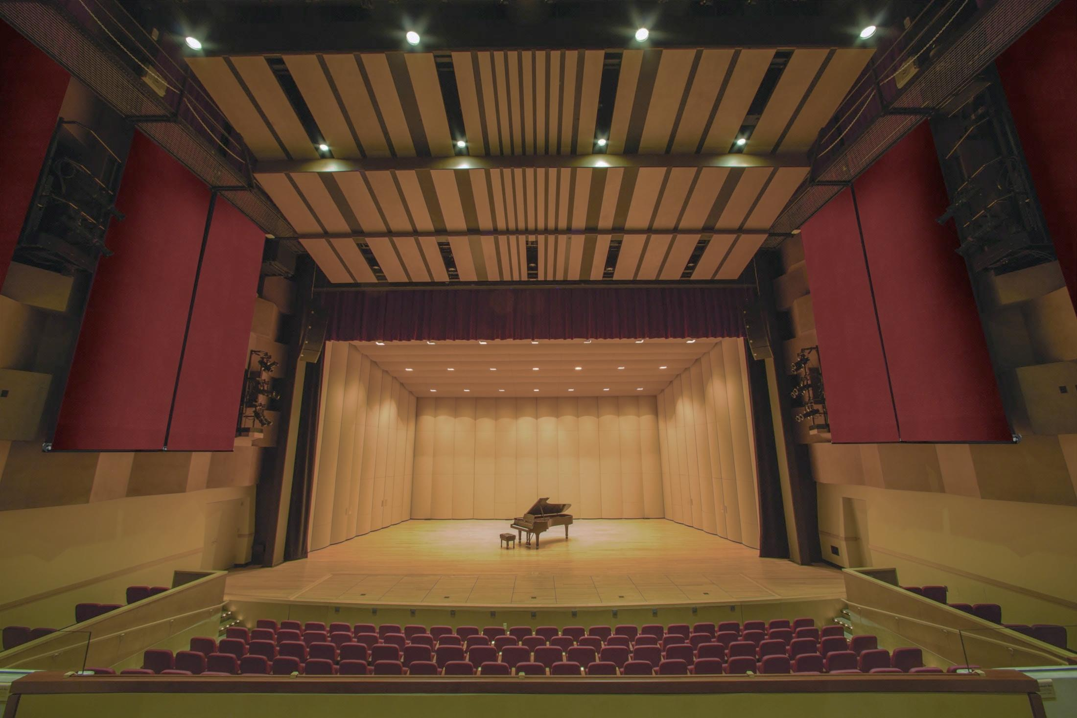


Reverberation
Sound waves get reflected from the walls and roof of a room multiple time. This causes a single sound to be heard not once but continuously. This is called reverberation.
Reflected sound
Actual sound
It produces bad quality of sound

Slide 41
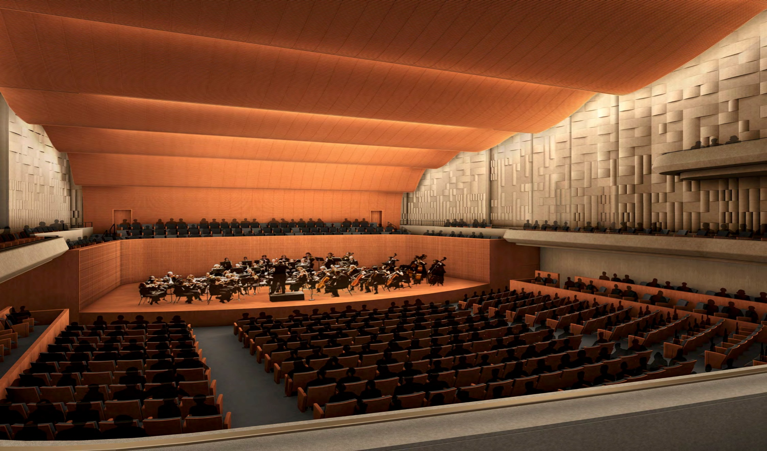
2 marks
The roof of a movie theatre and a conference hall is curved.
(i) Sound waves get reflected from the walls and roof of a room multiple times. This causes a single sound to be heard not once but continuously. This is called reverberation.
(ii) Due to reverberation some auditoriums or some particular seats in an auditorium have inferior sound reception which can be compensated with curtains.
(iii) Ceilings of these halls are made curved so that sound after reflecting from the ceiling, reaches all parts of the hall and the quality of sound improves.

Slide 42
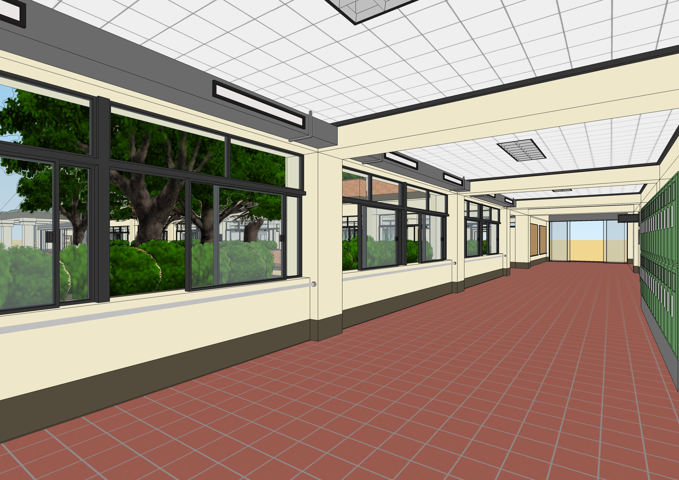
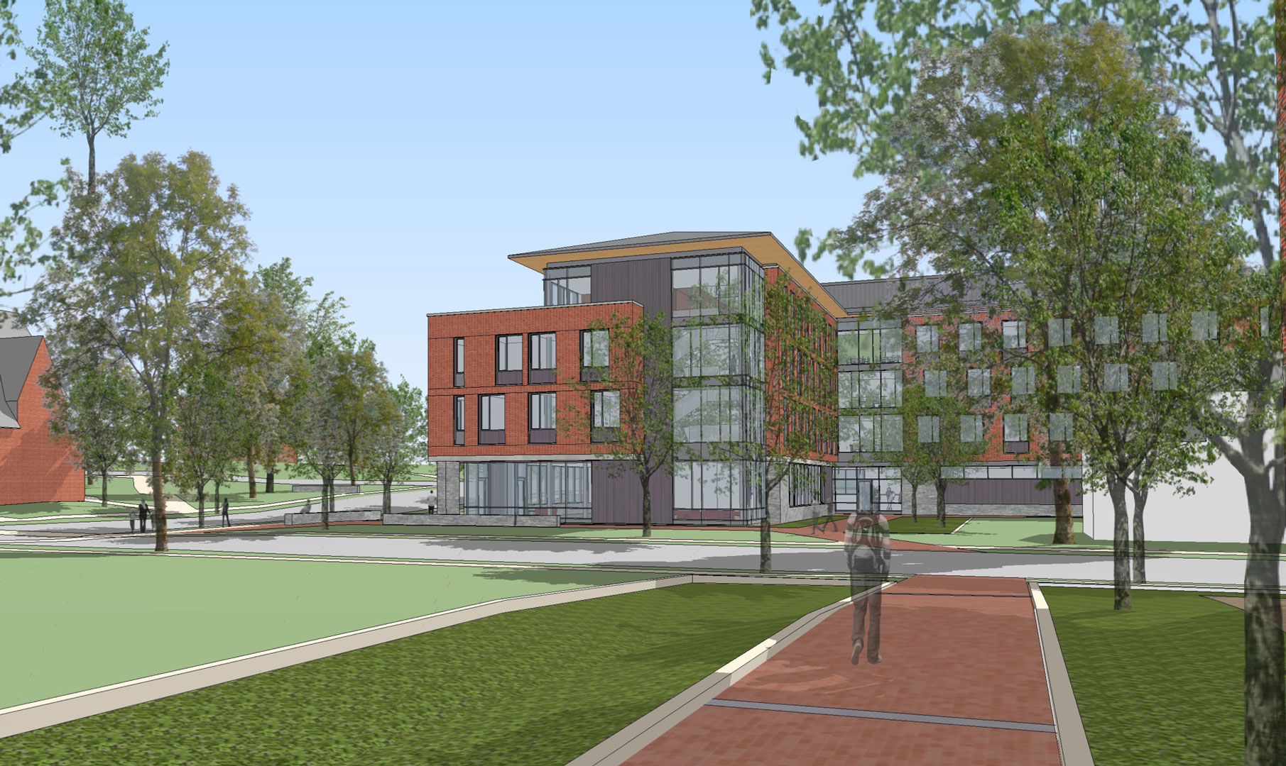
2 marks
How will you reduce reverberation in public halls or buildings?
By using sound absorbing materials like
curtains on wall, carpets on the floor.
By keeping the windows open, as sound will not get reflected.

Slide 43
2 marks
When is the reflection of sound harmful?
(i) Reflected sound of high intensity called as noise is disturbing and harmful to the ears.
(ii) When sound reverberates i.e it undergoes multiple reflection, poor quality of sound is produced.

Slide 44




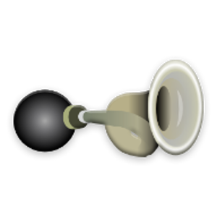
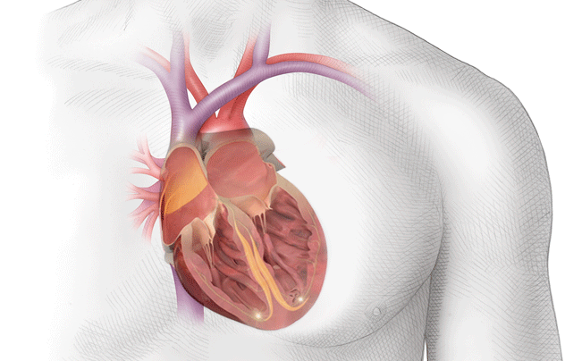
listening to sounds produced
USES OF MULTIPLE REFLECTION
OF SOUND
Megaphones or loudhailers, horns, musical instruments such as trumpets and shehanais, are all designed to send sound in a particular direction without spreading it in all directions.
Doctors listen to sound from the human body through stethoscope. The sound of heartbeat reaches the doctor’s ears by multiple reflection.
MEGAPHONES
TRUMPETS
HORN
Generally the ceilings of cinema halls and conference halls are curved so that sound after reflection reaches all corners of the hall, sometimes a curved sound board is placed behind the stage so that the sound,
after multiple reflection spreads evenly across the hall.

Slide 45
Module - 06

Slide 46

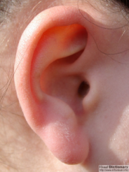

REFLECTION OF SOUND
FROM CURVED SURFACES
The sound is heard clearly when the listener and the source both are at focus.

Slide 47

VATICAN CITY
VATICAN CITY

Slide 48
Module - 07

Slide 49
STUDY OF SOUND
SONAR system

Slide 50
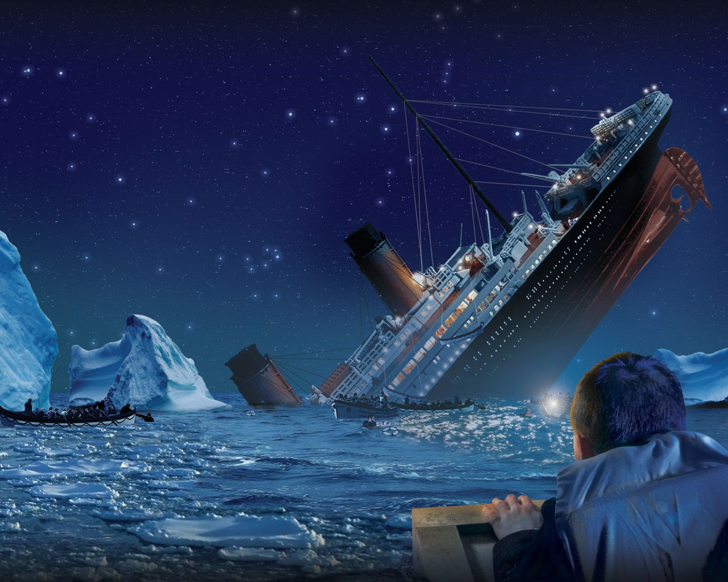
Why did the TITANIC sink?
Titanic did not have a SONAR system

Slide 51

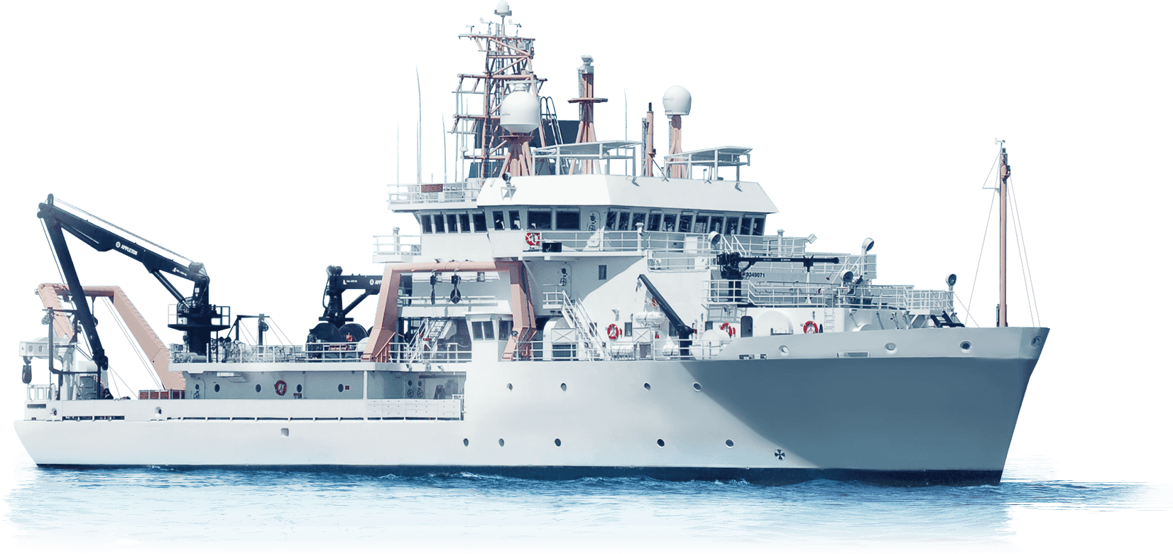
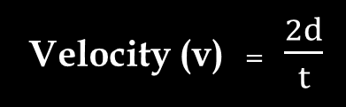
SONAR SYSTEM
Sound Navigation And Ranging
SONAR is used to determine the direction, distance and speed of an underwater object with the help of ultrasonic sound waves.
Transmitter
Detector
Transmitted pulse
Reflected pulse
This method is used to locate underwater hills, valleys, submarines, icebergs, sunken ships.
The depth of the sea or the distance of the object that reflected the sound can be calculated with the formula
Velocity (v) = $\frac{2d}{t}$

Slide 52
STUDY OF SOUND
Uses of Ultrasound

Slide 53




USES OF ULTRA SOUND
The special property of ultrasound is that they are able to travel along well defined path even in presence of obstacles.
Ultrasound are used to establish Ship to ship communication.

Slide 54
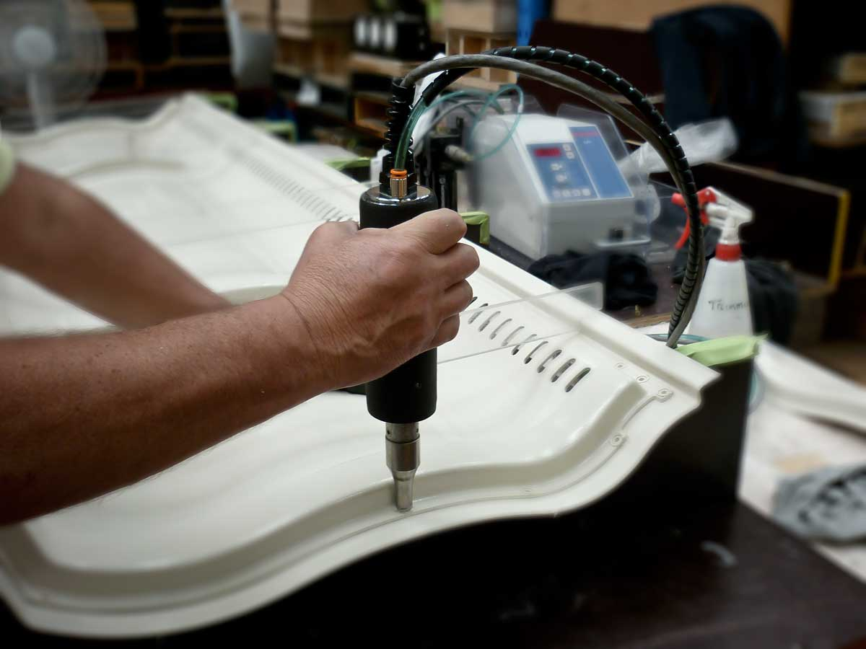


They are used for welding plastic surfaces.
Ultrasonic sound
( 20000 – 40000 Hz )
High energy vibrations
Electrical signal
Transducer
Advantages
Produce heat
No usage of bolts, nails, soldering materials or adhesive to join the material
Converts electrical energy into ultrasonic vibrations
Heat is produced hence plastic melts which leads to joining of plastics.
Heat produced

Slide 55

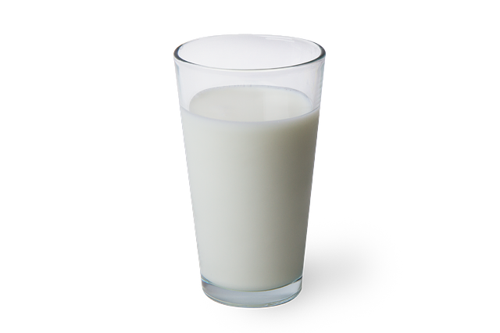




Ultrasonic waves are used to kill bacteria in liquids like milk to preserve them for a longer period of time.
Ultrasonic waves are used to kill bacteria to zero level which spoil the milk.
Advantages
Ultrasonic waves
Advantages
There is no decrease in level of protein or lactose content of milk.
On the other hand leads to increase in the fat concentration.

Slide 56
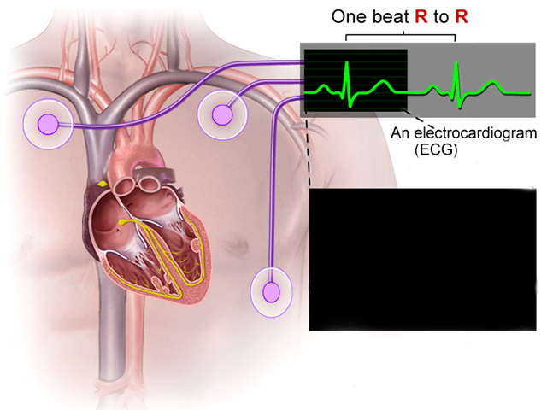

The echocardiography technique is based on ultrasonic waves
High frequency sound waves
Reflect the internal body parts
Transducer

Slide 57
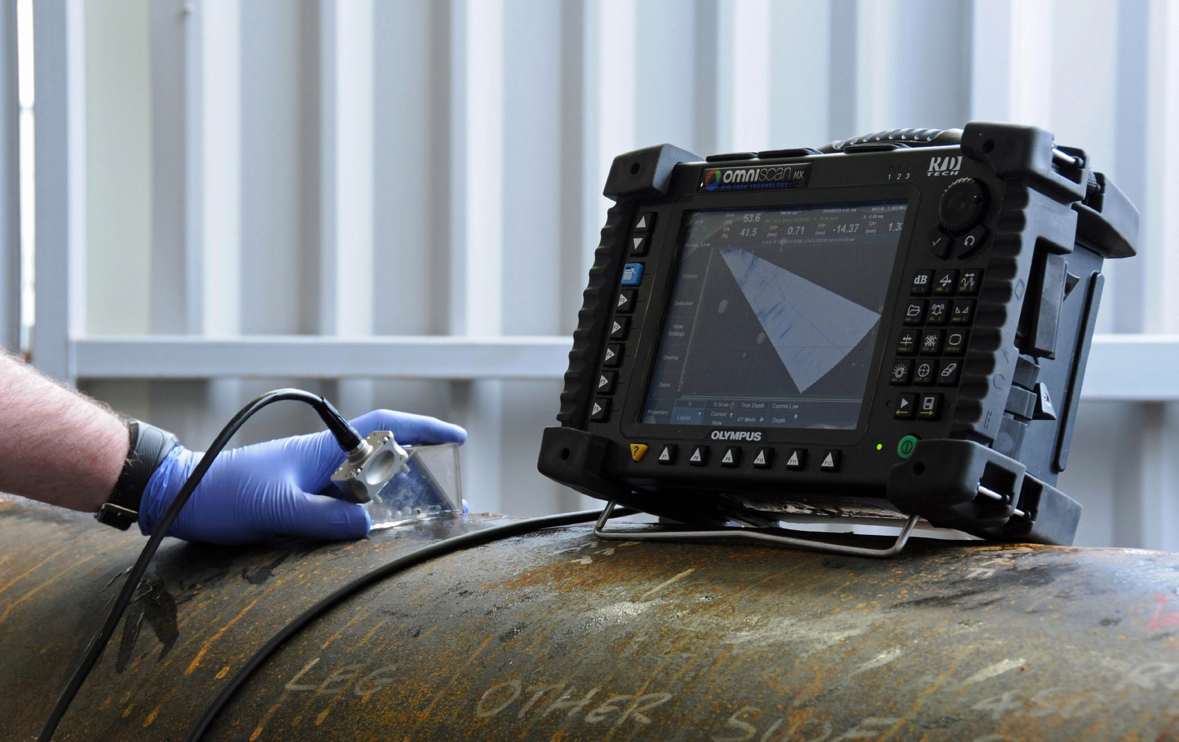
Cracks and flaws in metal blocks can also be detected by ultrasounds.

Slide 58
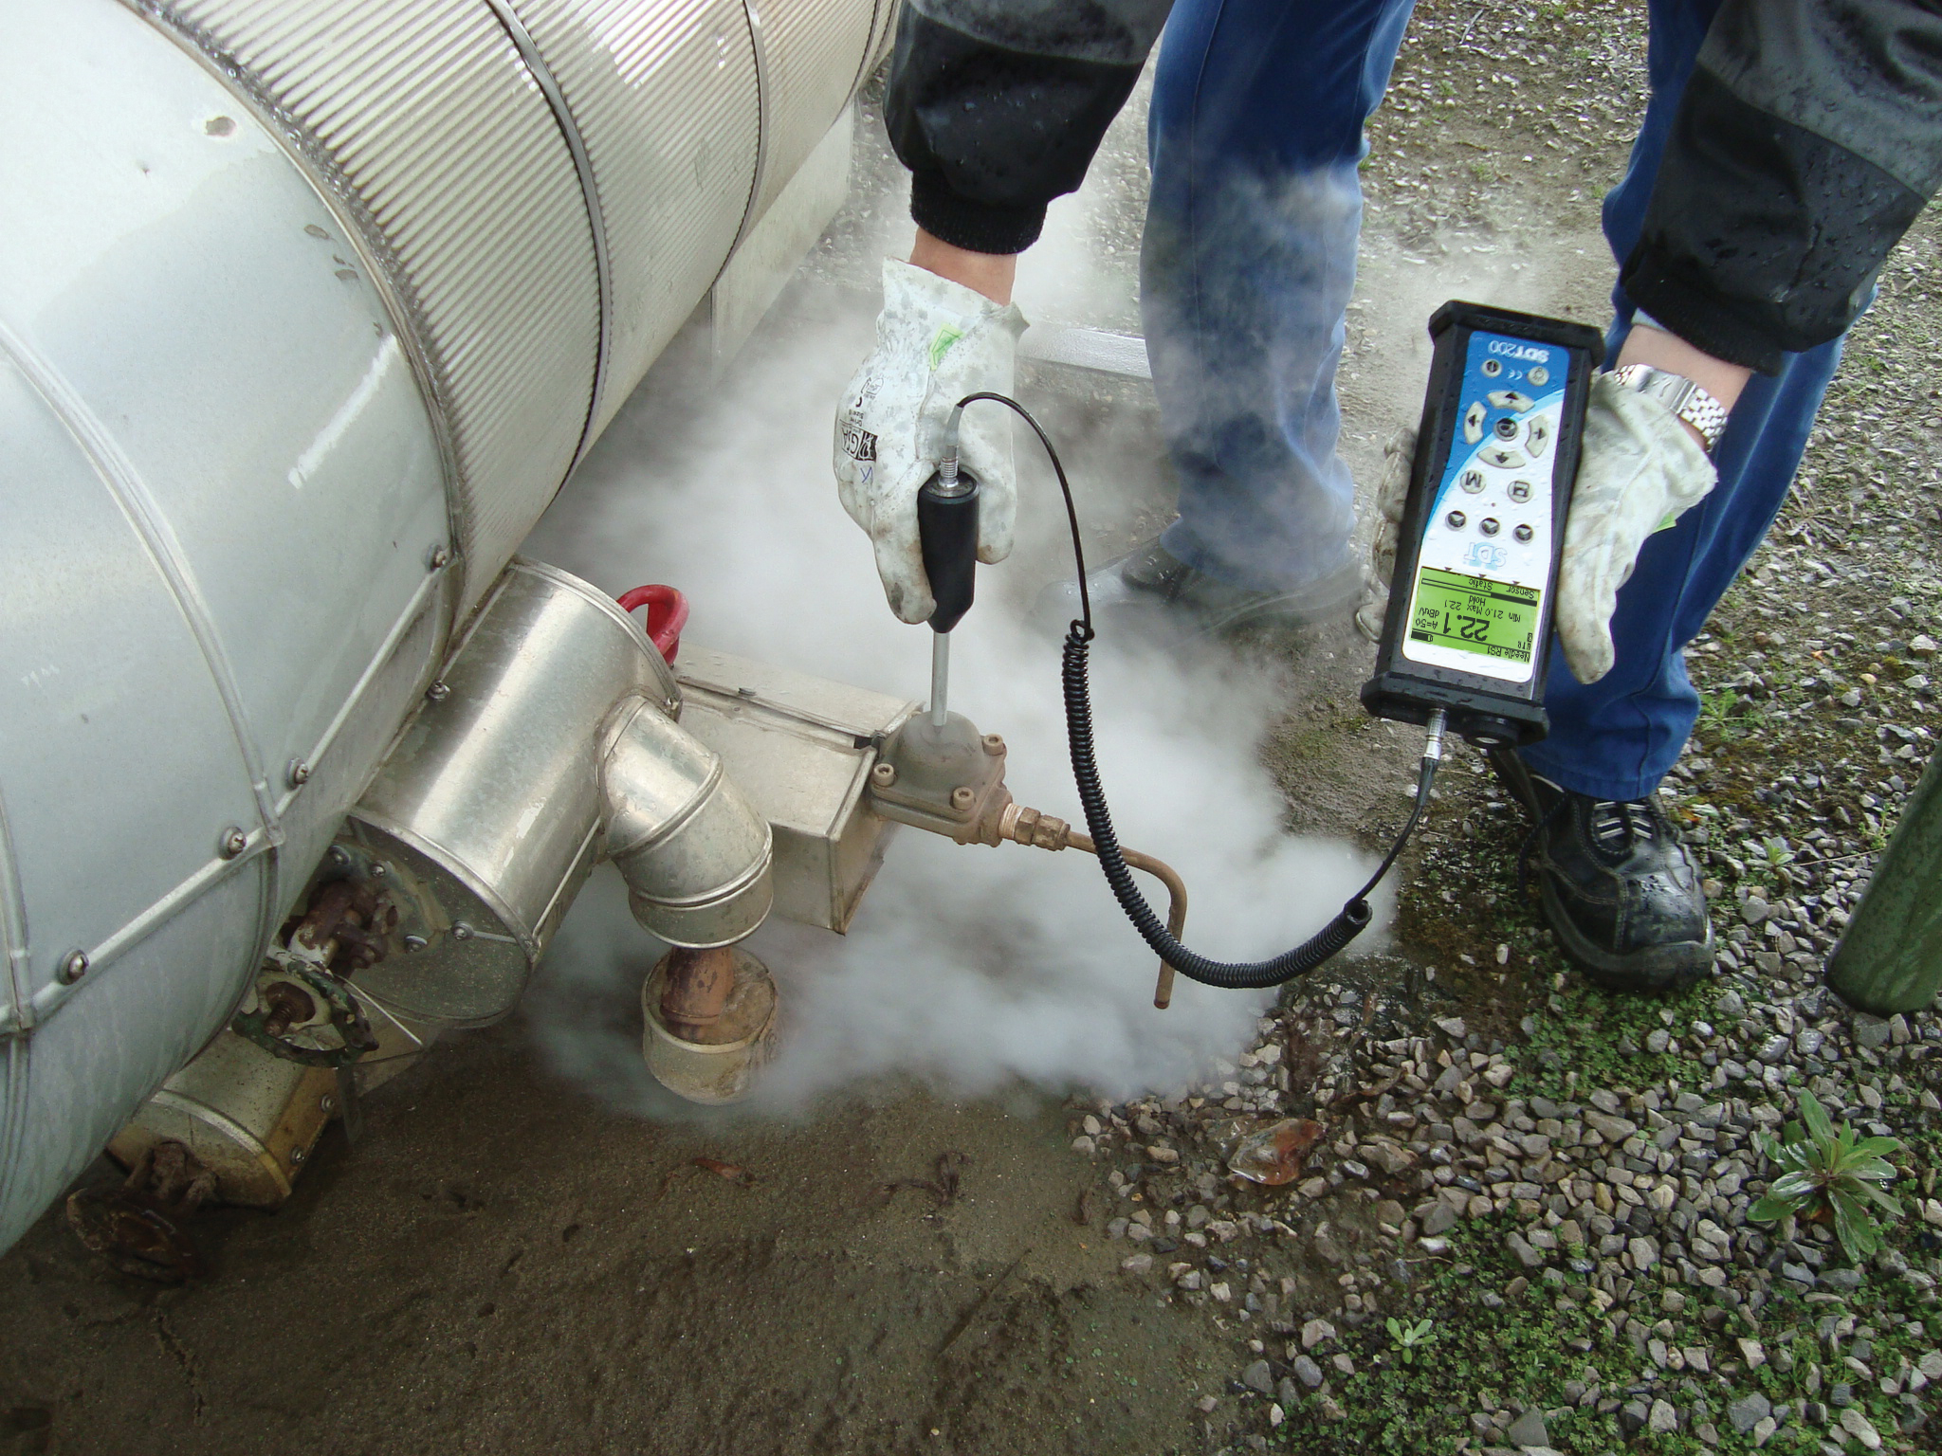
Ultrasounds are also useful in industries.
They are used to clean parts located in places which are difficult to reach.
Ultrasounds are high frequency waves
They enter the difficult parts
And clean these areas.

Slide 59
Q. Three different vibrating objects produce three different sounds X, Y and Z. Sounds X and Y cannot be heard by a man having normal range of hearing but sound Z can be heard easily. Sound X can be used in hospitals to break kidney stones of a patient into fine grains which then gets flushed out with urine. The sound Y is produced during an earthquake before the main shock waves is generated.
What type of sound is (i) X
(ii) Y
(iii) Z
- ultrasonic sound
- infrasonic sound
- Audible sound
(b) State the frequency range of sound X.
More than 20 kHz
(c) Name one device used in science laboratory that can produce sound like Y.
Simple pendulum
(d) Name one device in our home that can produce sound like Z.
Television
(e) What is the frequency range of sound like Z ?
20 Hz to 20 kHz

Slide 60
Q. If an explosion occurs at the bottom of the lake, what type of shock waves will be produced in water?
Ans :
If an explosion occurs at the bottom of the lake, infrasonic type of shock waves will be produced in water?
Q. Which among the following is an infrasonic wave?
(a) Waves generated through quartz crystals.
(b) Waves emitted by pest controllers.
(c) Waves generated during earthquake
(d) Waves emitted by a dog’s whistle.

Slide 61
Module - 08

Slide 62
STUDY OF SOUND
Characteristics of a wave

Slide 63

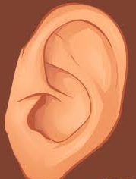
CHARACTERISTICS OF A WAVE
1) Wavelength (λ)
The distance between two consecutive compressions or two consecutive rarefactions is called wavelength.
It is measured in meters (m).
Crest
λ
Crest
1 wave = 1 oscillation
λ
2) Amplitude (A)
Trough
Trough
The maximum value of pressure or density is called amplitude.
λ
Rarefaction
3) Frequency (υ)
The frequency of a sound wave is defined as the number of complete oscillations of density (or pressure of the medium) per second. It is measured in hertz (Hz).
1
Compression
υ =
λ
T
4) Time Period (T)
5 s
The time taken for one complete oscillation of pressure or density at a point in the medium is called the time period.
2 s

Slide 64
STUDY OF SOUND
Relation between speed, frequency and wavelength

Slide 65

Relation between speed (v), frequency (υ), and wave length (λ)
distance
Speed
=
time
If we consider the distance travelled by the sound wave in one time period, then we get.
Wave length
Speed
=
In any medium, at fixed physical conditions, the velocity of sound of different frequencies is very nearly the SAME
Time period
Speed nearly remains same
As frequency increases…
Wavelength decreases…
λ
Will speed increase ?
v =
T
1
As frequency increases…
But, frequency (υ) =
T
v = υλ
i.e. speed = Frequency × Wavelength

Slide 66
Q. A sound wave of wavelength of λ and frequency f propagates through a gold rod and then exits into air. If λ’ and f’ are the new wavelength and frequency of the sound wave, then which of the following is true?
λ > λ’ and f = f’
b. λ = λ’ and f < f’
c. λ < λ’ and f = f’
d. λ = λ’ and f > f’
Q. If in a medium, a wave travels with velocity V and wavelength λ. When this same wave enters another medium, its velocity become 2V. What will be its wavelength in second medium?
λ
b. 2λ
c. λ/2
d. 4λ

Slide 67
Module - 09

Slide 68
STUDY OF SOUND
Characteristics of sound

Slide 69




CHARACTERISTICS OF SOUND
Amplitude
Pitch
Timbre
Generally girls sound is high pitch
Amplitude explains loudness of sound
Pitch explains shrillness in sound
Timbre explains quality of sound.
Every person has different timbre.
Amplitude is less, sound is soft.
Shorter wavelength, higher frequency, pitch is high
Generally boys sound is low pitch
Amplitude is more, sound is loud.
Larger wavelength, lower frequency, pitch is low
Intensity α (Amplitude)²

Slide 70


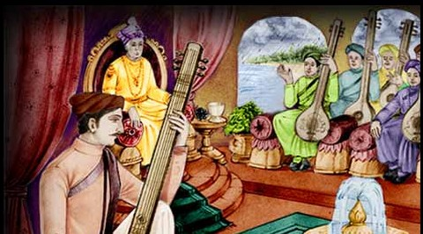
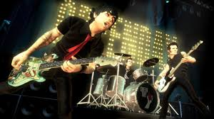
Tone
A sound of single frequency is called tone.
Minor Ditonic
Major Ditonic
Played in olden days.
Played now a days.
Express sadness
sadness
Express happiness.
happiness
The sound which is produced due to a mixture of different frequencies is called a note.
Note

Slide 71
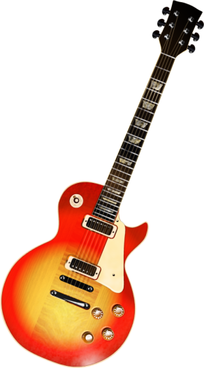

Q. Which wave property determines (a) loudness and (b) pitch
Ans :
(a) Loudness is determined by amplitude of sound waves
(b) Pitch is determined by the frequency of vibrations of the sound producing source.
Q. Guess which sound has a higher pitch: guitar or car horn?
Ans :
The sound from a guitar has a higher pitch than that from a car horn due to its higher frequency.

Slide 72
Difference between loudness and intensity
Loudness
Intensity
1. The sensation produced in the ears that enables us to distinguish between a feeble sound and a loud sound is called loudness of sound
1. The average energy transported by a sound wave per unit area, perpendicular to the direction of propagation, is called intensity of sound.
2. Loudness is measured in decibel (dB)
2. Intensity is measured in watts per square metre (W/m²)
3. S.I. unit of work is joule (J).
3. S.I. unit of power is watt (W).

Slide 73
Q. Consider the following sound waves marked A, B, C and D :
(A)
(B)
(C)
(D)
(a) Which two waves represents sound of same loudness but different pitch ?
Ans :
Waves A and C
(b) State whether all these sound waves are produced by same vibrating body or different bodies.
Ans :
Same vibrating body
(c) Which vibrating body/bodies could have generated the sound waves shown here
Ans :
Tuning fork

Slide 74
Q. Which of the two graphs (i) or (ii) representing human voice is likely to be a male voice ? Give reason for your answer.
(i)
(ii)
Wave
disturbance
Time (min)
Ans :
Graph (i) represent male voice.
Since the pitch and the frequency of a male voice is lower than the pitch of a female voice and vibration of graph (ii) represents a higher frequency and higher pitch.

Slide 75
Q. The following figures show the wave shapes of two sounds of same frequency. Which of these is likely to represent the sound produced by a car-horn ?
Wave
disturbance
Wave
disturbance
Time
Time
Soft sound
Louder sound
(A)
(B)
Ans :
Sound (B) because amplitude is large

Slide 76
Module - 10

Slide 77
SOUND
Numerical based on echo and kinematical equations

Slide 78
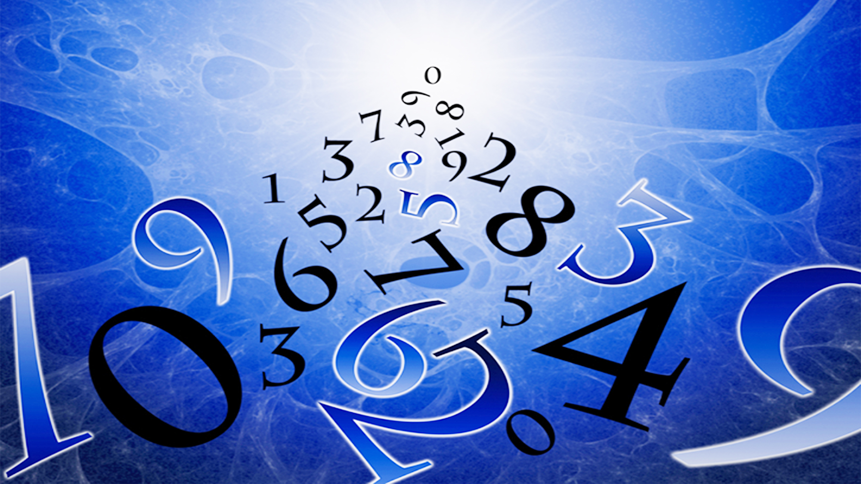

Type - A
v = λ × υ
numerical
Wavelength
distance
Speed
Frequency
Speed =
time
Note : When sound travels from one medium to another its frequency remains the same.

Slide 79
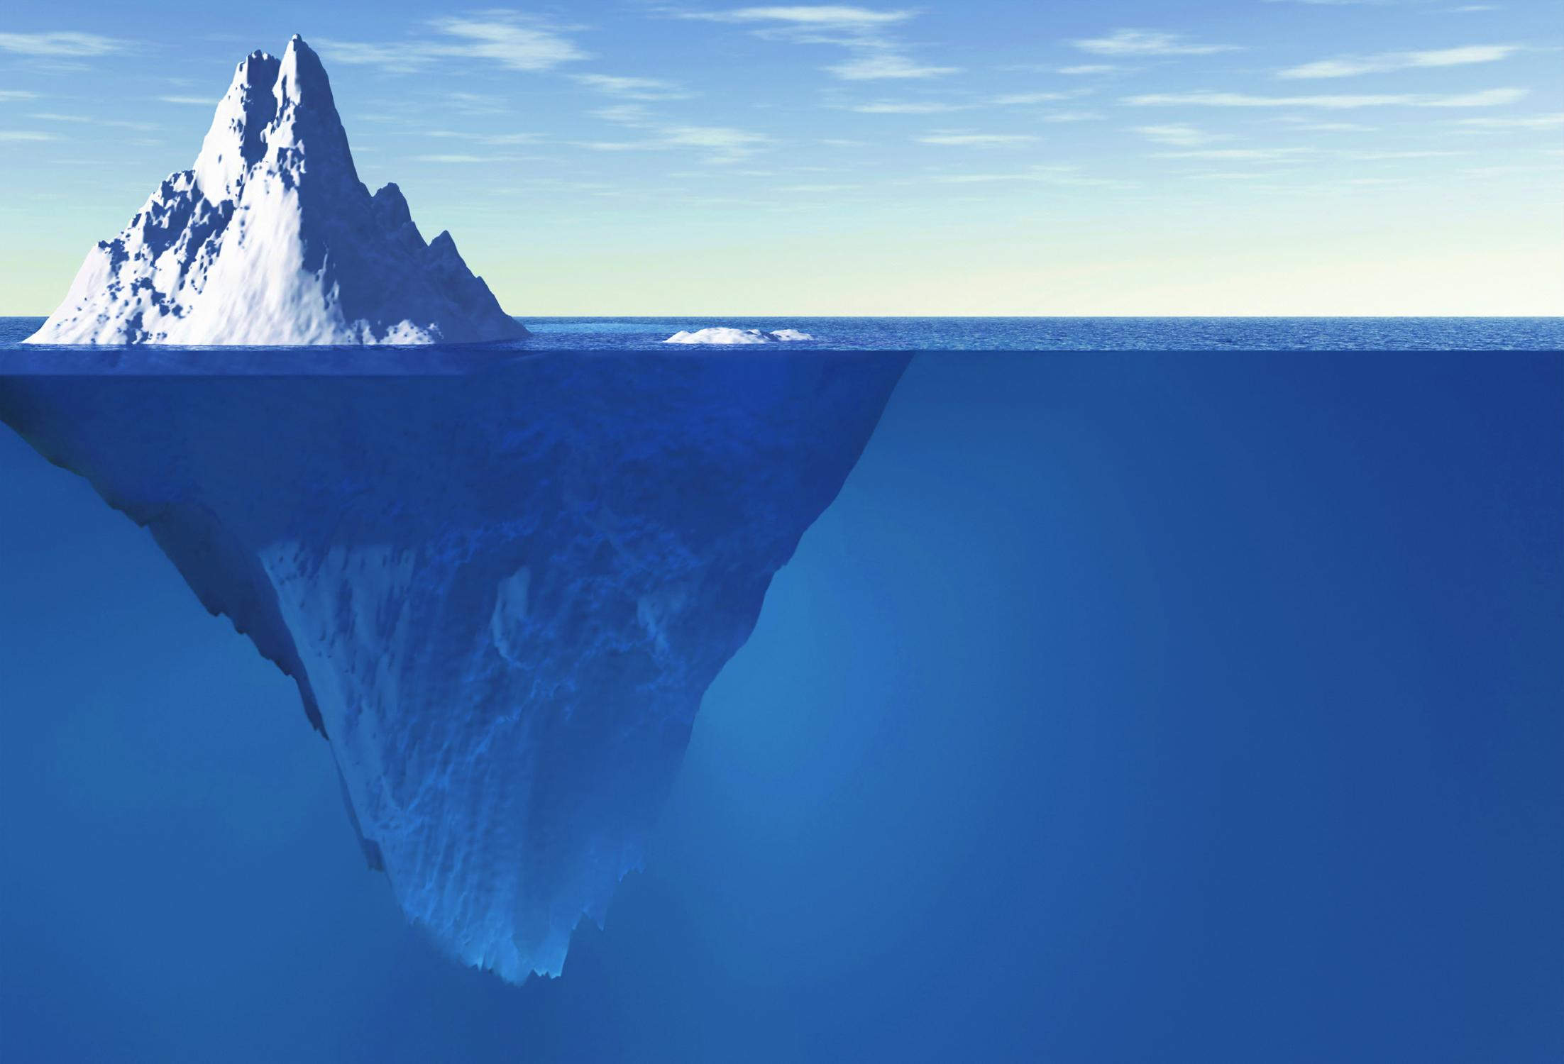
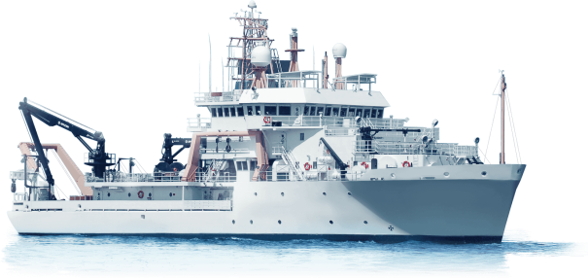


1. The drawing shows a ship 800 m from a cliff.
A gun is fired on the ship. After 5 seconds the people at the front of the ship hear the sound of the gun again.
After 5 seconds
800 m
(a) Name of the effect.
(b) What happens to the sound at the cliff.
(c) Distance travelled by the sound in 5 sec.
(d) Speed of sound.

Slide 80
1. The drawing shows a ship 800 m from a cliff.
A gun is fired on the ship. After 5 seconds the people at the front of the ship hear the sound of the gun again.
Given :
Distance from the cliff
= 800 m
(c)
Since, people on the ship heard the echo after 5 seconds,
Time taken to hear the echo
= 5 sec
To find:
Distance travelled by sound
(while going)
(after reflection)
(a) Name of the effect.
=
800 + 800
(b) What happens to the sound at the cliff.
=
1600 m
(c) Distance travelled by the sound in 5 secs.
∴ Sound travels a distance of 1600 m in 5 s.
(d) Speed of sound.
distance
1600
Formula :
Distance
= Speed × time
(d)
Speed
=
=
time
5
Solution :
(a)
Name of the effect is “ECHO”.
=
320 m/s
(b)
At the cliff, the sound gets reflected.
∴ Speed of Sound is 320 m/s.

Slide 81
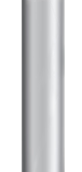

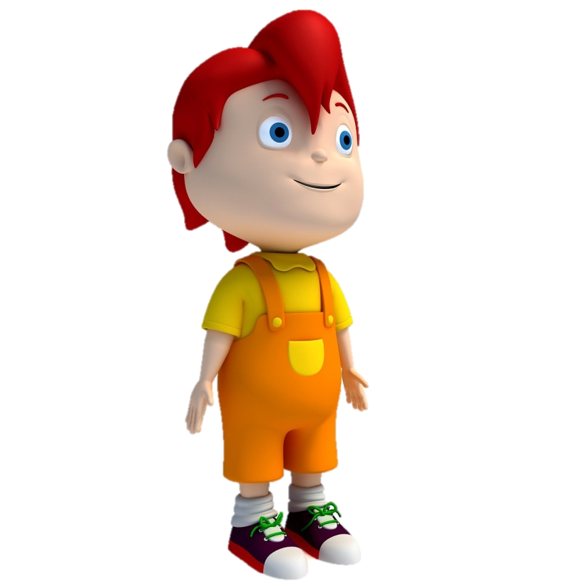


2. Two children are at opposite ends of an aluminium rod. One strikes the end of the rod with a stone. Find the ratio of times taken by the sound wave in air and in aluminium to reach the second child. ( velocity of sound in air = 346 m/s , velocity of sound in aluminum = 6420 m/s )
v _{air} = 346m/s
t _{air} = ?
AIR
v _{al} = 6420m/s
t _{al} = ?
Alumunium rod
d

Slide 82
2. Two children are at opposite ends of an aluminium rod. One strikes the end of the rod with a stone. Find the ratio of times taken by the sound wave in air and in aluminium to reach the second child. ( velocity of sound in air = 346 m/s , velocity of sound in aluminum = 6420 m/s )
Given :
Velocity of sound in air (v_{air})
= 346 m/s
velocity of sound in aluminium (v_{al})
= 6420 m/s
To find:
Ratio of times taken by sound wave in air and in aluminium (v_{air} / v_{al}) = ?
Formula :
d
t_{air}
6420
v
=
=
t
t_{al}
346
Solution :
Since the distance travelled by both the sound waves (d) is same, we get
t_{air}
18.55
=
t_{air}
v_{al}
t_{al}
1
=
t_{al}
v_{air}
Ans :
The ratio of the time taken by sound wave in air and aluminium is 18.55 : 1

Slide 83
Module - 11

Slide 84
SOUND
Numerical based on speed, frequency and wavelength.

Slide 85


3. A child shouted ‘Hello’ near a cliff and heard the echo after some time. If the speed of sound is taken as 345 m/s at respective temperature and the distance of cliff from the child is 690 m. Calculate the time after which echo is heard by the child.
Distance = 690 m
Distance = 690 m

Slide 86
3. A child shouted ‘Hello’ near a cliff and heard the echo after some time. If the speed of sound is taken as 345 m/s at respective temperature and the distance of cliff from the child is 690 m. Calculate the time after which echo is heard by the child.
Given :
Total distance travelled by sound (d)
distance from child to cliff
distance from cliff to child
=
+
= 690 + 690
= 1380 m
Velocity of sound
= 345 m/s
To find:
Time (t) = ?
distance
Formula :
velocity
=
time
distance
Solution :
velocity
=
time
Time (t) = 4 sec
1380
Ans :
The echo is heard by the child
4 second after shouting.
time
=
345

Slide 87

4. The frequency of a source of sound is 100 Hz. How many times does it vibrate in a minute?
Given :
frequency (υ)
= 100 Hz
time (t)
= 60 sec
To find :
No. of vibrations in 60 sec
= ?
No. of vibrations
Formula :
frequency
=
time
No. of vibrations
Solution :
frequency
=
time
∴
frequency × time
= No. of vibrations
∴
100 × 60
= No. of vibrations
∴
No. of vibrations
= 6000
Ans :
The source vibrates 6000 times in a minute

Slide 88
Module - 12

Slide 89
SOUND
Numerical based on speed, frequency and wavelength.

Slide 90

5. A person is listening to a sound of 500 Hz sitting at a distance of 450 m from the source of the sound. What is the time interval between successive compressions from the source?
Given :
frequency (ν)
= 500 Hz
distance (d)
= 450 m
To find :
Time period (T)
= ?
Compressions
Compressions
Formula :
1
ν
=
T
T
1
Solution :
ν
=
T
1
∴
T
=
ν
1
∴
T
=
Ans :
The time interval between successive compressions i.e time period is 0.002 sec.
500
∴
T
= 0.002 sec

Slide 91
6. A sound wave has a frequency of 2 kHz and wavelength 35 cm. how long will it take to travel 1.5 km ?
Given :
frequency (ν)
= 2 kHz
= 2000 Hz
Wavelength (λ)
= 35 cm
= 0.35 m
Distance (d)
= 1.5 km
= 1500 m
To find :
Time (t)
= ?
distance
distance
Formula :
velocity
=
velocity
=
time
time
v
= ν λ
distance
∴
time
=
Solution :
v
= ν λ
velocity
∴
v
= 2000 × 0.35
1500
∴
t
=
∴
v
= 700 m/s
700
∴
Time (t)
= 2.1 s
Ans :
Thus, sound will take 2.1 s to travel a distance of 1.5 km.

Slide 92
Module - 13

Slide 93
SOUND
Numerical based on speed, frequency and wavelength.

Slide 94
7. The human ear can detect continuous sounds in the frequency range from 20 Hz to 20000 Hz. Assuming that the speed of sound in air is 330 ms^{–1} for all frequencies, Calculate the wavelengths corresponding to the given extreme frequencies of the audible range.
Given :
Frequency (ν₁)
=
20 Hz
Frequency (ν₂)
=
20000 Hz
Speed (v)
=
330 ms⁻¹
To find :
Wavelengths (λ₁) and (λ₂) = ?
Formula :
v
= ν λ
v
330
Solution :
λ₁
=
=
=
16.5 m
υ₁
20
v
330
165
λ₂
=
=
=
=
0.0165 m
υ₂
20000
10000
Ans :
The range of wavelength is 16.5 m to 0.0165 m.

Slide 95
8. A sound wave travels at a speed of 339 m/s. If its wavelength is 1.5 cm, what is frequency of the wave? Will it be audible to humans ?
Given :
Speed of sound (v)
=
339 m/s
Wavelength (λ)
=
1.5 cm
=
330 ms⁻¹
To find :
Frequency (ν) = ?
Formula :
v
= ν λ
Solution :
v
= ν λ
v
∴
ν
=
λ
113
200
339
339 × 1000
Ans :
Frequency of the wave is 22,600 Hz and it is not audible to human.
∴
ν
=
=
0.015
15
3
1
∴
ν
= 22,600 Hz

Slide 96
Module - 14

Slide 97
SOUND
Numerical based on speed, frequency and wavelength.

Slide 98
9. A sound wave has wave length 1.5 m in a gas and 0.8 m in air. Calculate: (a) Frequency of sound and (b) Velocity of sound in gas if velocity of sound in air is 340m/s
Given :
wavelength in gas (λ_{g})
= 22,600 Hz
But frequency does not change with change in medium.
Wavelength (λ_{g}) = 1.5 m
Gas
wavelength in air (λ_{a})
= 0.8 m
velocity of sound in air (v_{a})
= 340 m/s
∴
ν_{a}
= ν_{g}
To find :
Frequency (ν)
= ?
∴
v_{g}
= ν_{g} λ_{g}
Velocity of sound in gas (v_{g})
= ?
∴
v_{g}
= 425 × 1.5
Formula :
v
= ν λ
Wavelength (λ_{a}) = 0.8 m
Air
∴
v_{g}
= 637.5 m/s
Solution :
v_{a}
= ν_{a} λ_{a}
v_{a}
Ans :
Frequency of sound is 425 Hz and velocity of sound in gas is 637.5 m/s
∴
ν_{a}
=
λ_{a}
340
∴
ν_{a}
=
0.8
∴
ν_{a}
= 425 Hz

Slide 99
10. Calculate distance travelled by a sound wave having frequency 1000 Hz and wavelength 0.25 m, if it travels for 5 second in a certain medium.
Given :
frequency (ν)
= 1000 Hz
Wavelength (λ) = 0.25 m
wavelength (λ)
= 0.25 m
time (t)
= 5 sec
To find :
distance (d)
= ?
t = 5 sec
Frequency = 1000Hz
distance
distance
Formulae :
velocity =
velocity =
time
time
v
= ν λ
∴
distance
= velocity × time
Solution :
v
= ν λ
∴
distance
= 250 × 5
∴
v
= 1000 × 0.25
∴
distance
= 1250 m.
∴
v
= 250 m/s
Ans :
The distance travelled by a sound wave is 1250 m.

Slide 100
Module - 15

Slide 101
STUDY OF SOUND
Human ear

Slide 102
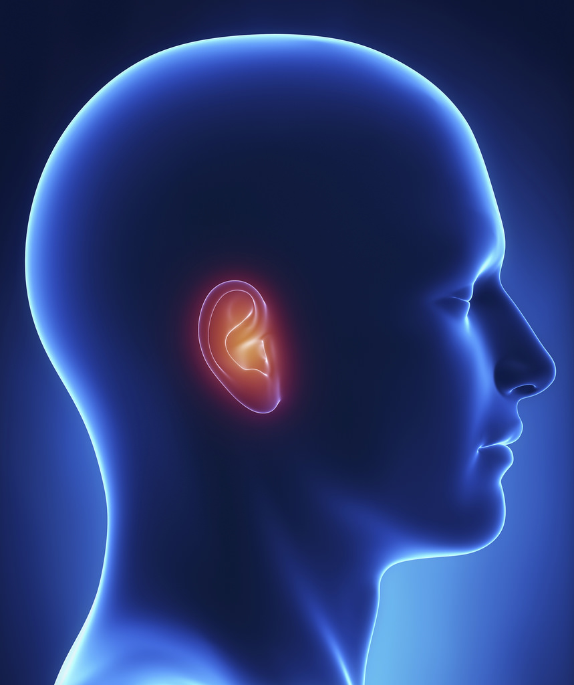



human ear
Chain of three bones
Outer ear
(Pinna)
Semi – circular canals
Stapes
Auditory
canal
Cochlea
Eustachian
tube
Tympanic cavity
Ear drum
Outer ear
Middle ear
Inner ear
Outer ear
Middle ear
Inner ear

Slide 103

STRUCTURE OF
HUMAN EAR
STRUCTURE OF
HUMAN EAR

Slide 104

STRUCTURE OF
HUMAN EAR
STRUCTURE OF
HUMAN EAR

Slide 105


Slide 106


Slide 107
human ear
Chain of three bones
Outer ear
(Pinna)
Semi – circular canals
Stapes
Auditory
canal
Cochlea
Eustachian
tube
Tympanic cavity
Ear drum
Outer ear
Middle ear
Inner ear

Slide 108

Match the columns
Column 1
Column 2
At the end of auditory canal there is a thin membrane.
Pinna
Ear Drum
The outer ear is called pinna.
It converts the pressure variations into electrical signals.
Auditory nerve
It sends the electrical signals to the brain.
Auditory canal
The collected sound passes through auditory canal.
Cochlea

Slide 109
Module - 16

Slide 110
SOUND
Numerical based on echo and kinematical equations

Slide 111

Type - B
2d
v =
(for Echo)
numerical
t
v = u + gt
ut + $\frac{\text{1}}{\text{2}}$ gt²
s =
v² = u² + 2gs

Slide 112



1. A submarine emits a sonar pulse, which returns from an underwater cliff in 1.02 s. If the speed of sound in salt water is 1531m/s, how far away is the cliff ?
Distance of the submarine from the cliff?
speed of sound in water is 1531m/s
t = 1.02 sec

Slide 113
1. A submarine emits a sonar pulse, which returns from an underwater cliff in 1.02 s. If the speed of sound in salt water is 1531m/s, how far away is the cliff ?
Given :
velocity of sound in sea water (v)
= 1531 m/s
Time to hear echo (t)
= 1.02 sec
To find :
Distance between cliff and submarine
= ?
Formula :
2d
v
=
t
2d
Solution :
v
=
t
v × t
∴
d
=
2
0.51
1531 × 1.02
Ans :
The distance between cliff and submarine is 780.81 m
∴
d
=
2
∴
d
= 780.81 m

Slide 114


2. The speed of sound in water is 1500 metres per second. How far away from an under-sea rock should a deep sea diver be so that he can hear his own echo?
speed of sound in water is 1500 metres per second.
Distance of the diver from the rock?

Slide 115
2. The speed of sound in water is 1500 metres per second. How far away from an under-sea rock should a deep sea diver be so that he can hear his own echo?
Given :
Speed of sound in water
= 1500 m/s
Time taken to hear the echo (t)
= 0.1 sec
To find :
Distance of the diver from the rock
= ?
Formula :
2d
v
=
t
2d
Solution :
v
=
t
v × t
∴
d
=
2
750
1500 × 0.1
Ans :
The deep sea diver should be 75 m away from the under sea rock so that he can hear his echo.
∴
d
=
2
∴
d
= 75 m

Slide 116
Module - 17

Slide 117
SOUND
Numerical based on echo and kinematical equations

Slide 118

3. An echo was heard after 3s. What is the distance of the reflecting surface from the source, given that the speed of sound is 342m/s ?
Given :
Speed of sound (v)
= 342 m/s
Time taken to hear the echo (t)
= 3s
To find :
Distance
= ?
2d
t = 3 sec
Formula :
v
=
t
2d
Solution :
v
=
t
v × t
∴
d
=
2
342 × 3
Ans :
The distance from the reflecting surface is 513 m .
∴
d
=
2
∴
d
= 513 m

Slide 119

4. A person clapped his hands near a cliff and heard the echo after 5 s. What is the distance of the cliff from the person if the speed of the sound, v is taken as 346 ms⁻¹?
Given :
Speed of sound (v)
= 346 ms^{–1}
Time taken for hearing the echo (t)
= 5s
To find :
Distance
= ?
Formula :
2d
v
=
t
2d
5 s
Solution :
v
=
t
v × t
∴
d
=
2
173
346 × 5
Ans :
Distance of the cliff from the person is 865 m
∴
d
=
2
∴
d
= 865 m

Slide 120
Module - 18

Slide 121
SOUND
Numerical based on echo and kinematical equations

Slide 122


5. A ship sends out ultrasound that returns from the seabed and is detected after 3.42 s. if the speed of ultrasound through seawater is 1531 m/s.
what is the distance of the seabed from the ship ?
A ship sends out ultrasound that returns from the seabed
detected after 3.42 s
the speed of ultrasound through
seawater is 1531 m/s.
what is the distance of the seabed from the ship ?
Given :
Time between transmission and detection (t)
= 3.42 s
Speed of ultrasound in sea water (v)
= 1531 m/s
To find :
Distance
= ?
2d
Transmitter
Detector
Formula :
v
=
t
3.42 s
2d
Solution :
v
=
t
v × t
∴
d
=
∴
d
= 2618 m
2
1.71
1531× 3.42
Ans :
The distance of the seabed from the ship is 2618 m or 2.62 km
∴
d
=
2

Slide 123
6. A SONAR device on a submarine sends out a signal and receives an echo after 6sec. Find the distance between the object and the submarine. (speed of ultrasound = 1531 m/s)
Given :
Time between transmission and detection (t)
= 6 s
Speed of ultrasound in seawater (v)
= 1531 m/s
To find :
Distance
= ?
Formula :
2d
v
=
t
2d
Solution :
v
=
t
v × t
∴
d
= 4593 m
∴
d
=
2
3
Ans :
The distance between the object and the submarine is 4593 m.
1531× 6
∴
d
=
2

Slide 124
Module - 19

Slide 125
SOUND
Numerical based on echo and kinematical equations

Slide 126





7. A stone is dropped from the top of a tower 500 m high into a pond of water at the base of the tower. When is the splash heard at the top? Given, g = 9.8m/s² and speed of sound = 340m/s².
u = 0m/s
Time taken by stone to reach the pond (t₁)
Time taken by sound to reach the man (t₂)
∴ Time after which sound is heard by man(t) = (t₁ + t₂)
s = 500 m

Slide 127
7. A stone is dropped from the top of a tower 500 m high into a pond of water at the base of the tower. When is the splash heard at the top? Given, g = 9.8m/s² and speed of sound = 340m/s².
Given :
height of tower (s)
= 500 m
500 =
5 t₁²
velocity of sound in air (v)
= 340 m/s
500
∴ t₁² =
Acceleration due to gravity (g)
= 10 m/s²
5
Initial velocity of stone (u)
= 0 m/s
t₁² = 100
To find :
Time after which the splash is heard (t) = ?
∴ t₁ = 10 sec
d
d
Let t₂ be the time taken by sound to reach from the pond to the top of tower
Formulae :
v
=
, s
= ut + gt²
t
t
Solution :
Let t₁ be the time taken by stone to pull from tower.
d
d
500
v =
∴ t₂ =
=
= 1.47 sec
∴ From 2nd equation of motion
t₂
v
340
1
∴ The splash is heard at the top after time t :
s = ut₁ +
gt₁²
2
1
t = t₁ + t₂
= 10 + 1.47
= 11.47 sec
500 =
0 × t₁
+
× 10 × t₁²
Ans :
2
The splash is heard after 11.47 sec.

Slide 128
Module - 20

Slide 129
SOUND
Numerical based on echo and kinematical equations

Slide 130

8. A soldier standing between two cliffs X and Y, fires a gun. After firing the gun he hears the first echo after 3.4 seconds and second echo after 4 seconds. Find the distance between the two cliffs.
(speed of sound in air = 340 m/s)
Given :
Total Time of echo = 3.4 + 4
= 7.4 sec
7.4
Time (t)
=
= 3.7 sec
2
Velocity of sound (v)
= 340 m/s
To find :
distance (d) = ?
distance
Formula :
velocity
=
time
distance
Solution :
velocity
=
Time of Echo from Y Cliff = 4 sec
Time of Echo
From Cliff = 3.4 sec
time
Y cliff
X cliff
distance
=
velocity × time
distance
=
340 × 3.7
Ans :
The distance between the two cliff is 1258 m.
d
=
1258 m

Slide 131
Module - 21

Slide 132
SOUND
Additional Numericals

Slide 133
1. The graph shows the displacement versus time relation for a disturbance travelling with velocity 1500 ms⁻¹. Calculate the wavelength of the disturbance.
Given :
Velocity (v)
= 1500 ms⁻¹
Time period (T)
= 2 μs
To find :
Wavelength (λ) = ?
Displacement
(m)
Time
0
λ
1
2
3
4
5
Formula :
v
=
T
λ
Time (μs) →
Solution :
v
=
T
∴
λ
= v × T
∴
λ
= 1500 × 2 × 10⁻⁶
Ans :
The wavelength of the disturbance is 3 × 10⁻³ m
∴
λ
= 3000 × 10⁻⁶
∴
λ
= 3 × 10⁻³ m

Slide 134



2. A girl standing 150 m in front of tall buildings, fires a shot using a starting pistol. A boy, standing 350 m behind her, hears two bangs 1 s apart. What is the speed of sound ?
t₂
t₁
150 m
350 m

Slide 135
2. A girl standing 150 m in front of tall buildings, fires a shot using a starting pistol. A boy, standing 350 m behind her, hears two bangs 1 s apart. What is the speed of sound ?
Solution :
Time of sound from girl to boy
= t₁
Time of sound from girl to building
= t₂
Case 1
Time of 1st sound (Girl - boy)
= t₁
Case 2
=
2t₂ + t₁
Time of 2nd sound (Girl - building – boy)
t₂ + t₂ + t₁
Time difference
= Case 2 – Case 1
1
= 2 t₂ + t₁ – t₁
1
= 2 t₂
1
t₂
=
= 0.5 s
2
distance
150
Speed
=
=
= 300 m/s
time
0.5

Slide 136
Module - 22

Slide 137
SOUND
Additional Questions

Slide 138





Q. A girl is sitting in the middle of a park of dimension 22m × 22m. On the left side of it there is a building adjoining the park and on the right side of the park, there is a road adjoining the park. A sound is produced on the road by a cracker. Is it possible for the girl to hear the echo of this sound? Explain your answer.
22 m
11 m
Ans :
No, it is not possible for the girl to hear the echo of this sound, because the distance between the girl and the building is only 11m approximately. For echo to be heard, the minimum distance between the observer and the source of sound and the obstacle should be 17 m.
22 m

